Slide 1
Project 1 Status Report
Charlotte Teague
CS 418
February 4, 2015

Slide 2
I started by downloading and installing XAMPP version 3.2.1

Slide 3
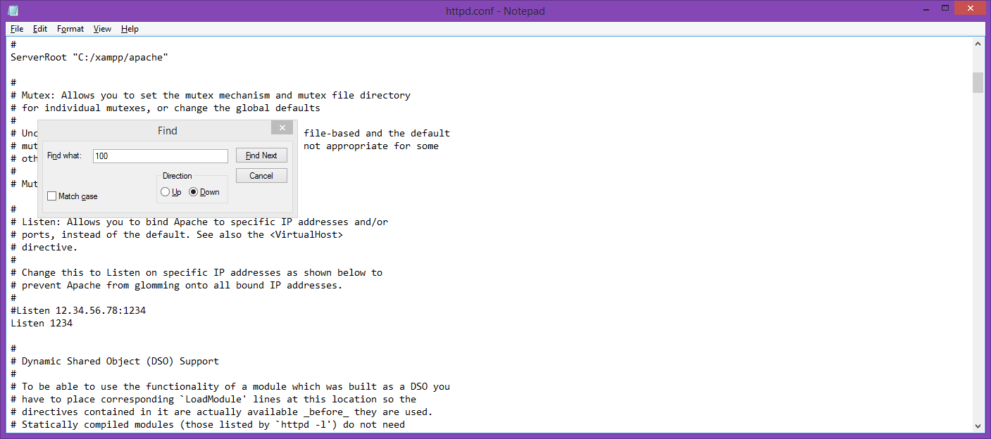
I had to change the port number from 80 to anything because that port was already occupied. I chose 1234.

Slide 4
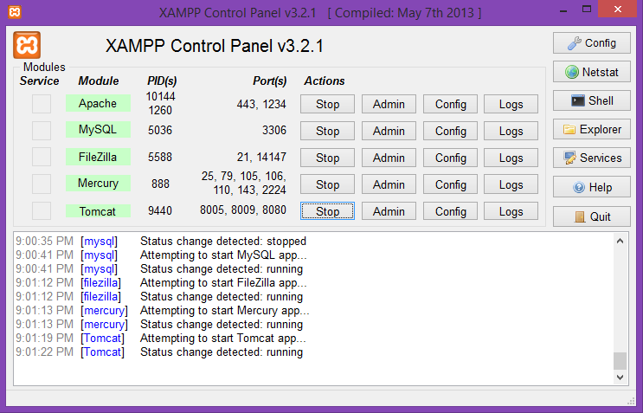
I started the XAMPP processes

Slide 5
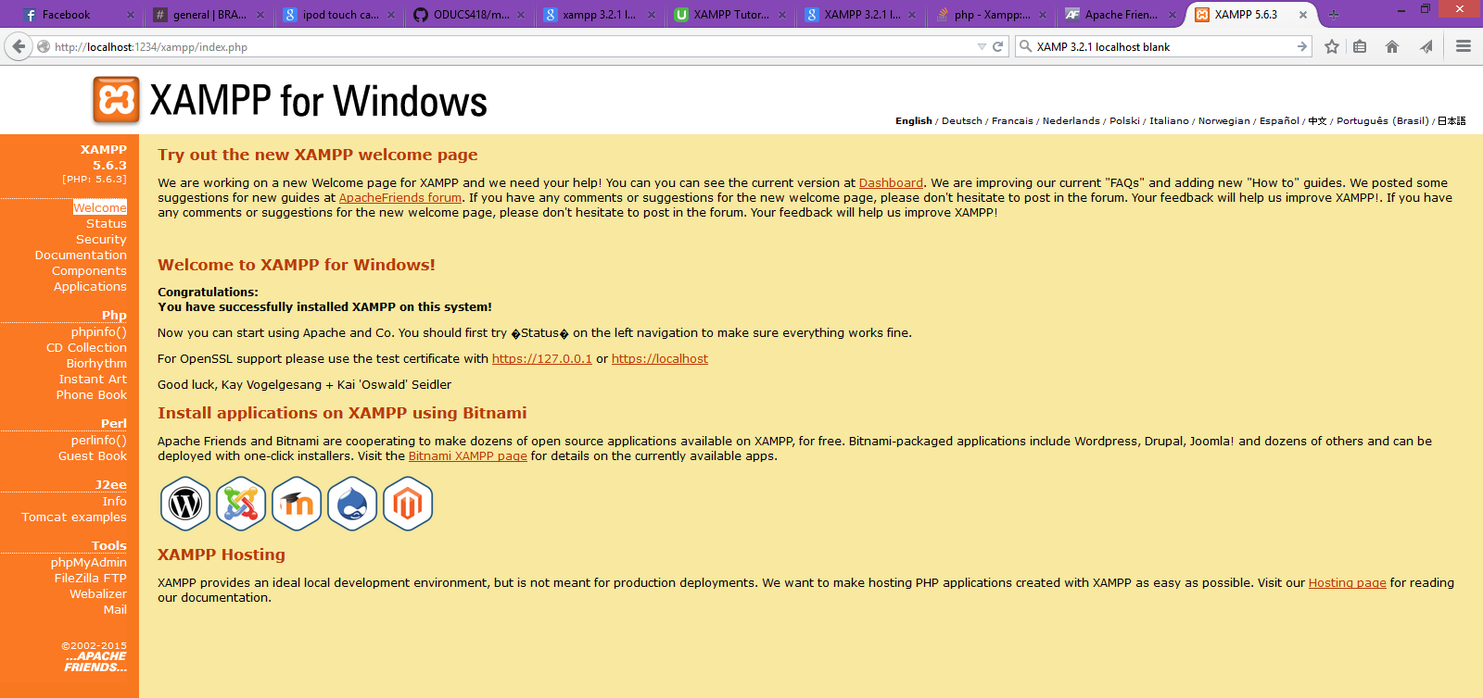
I then proceeded to test the installation.

Slide 6
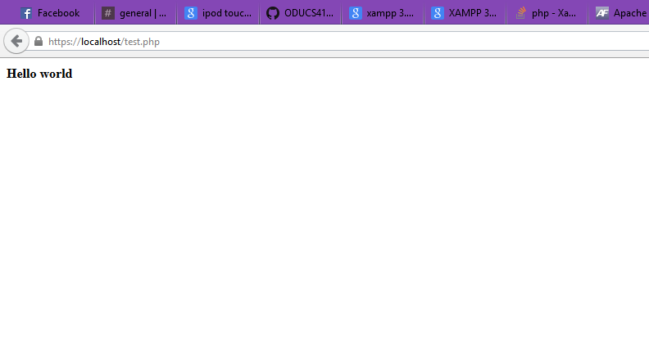
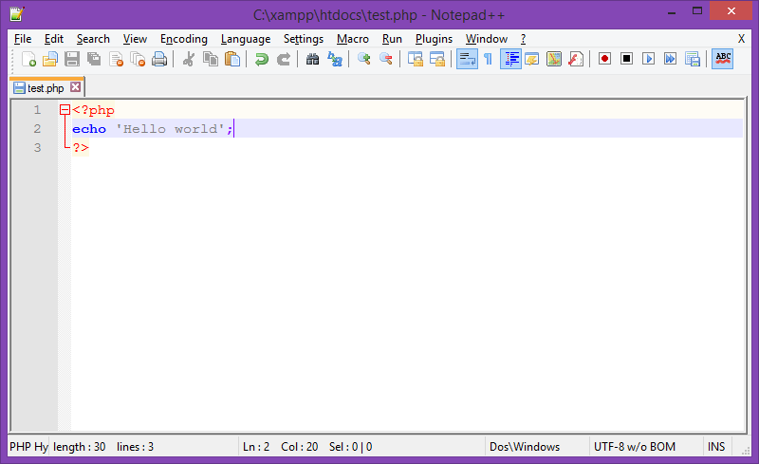
I created a php ‘Hello world’ file and tested the file.

Slide 7
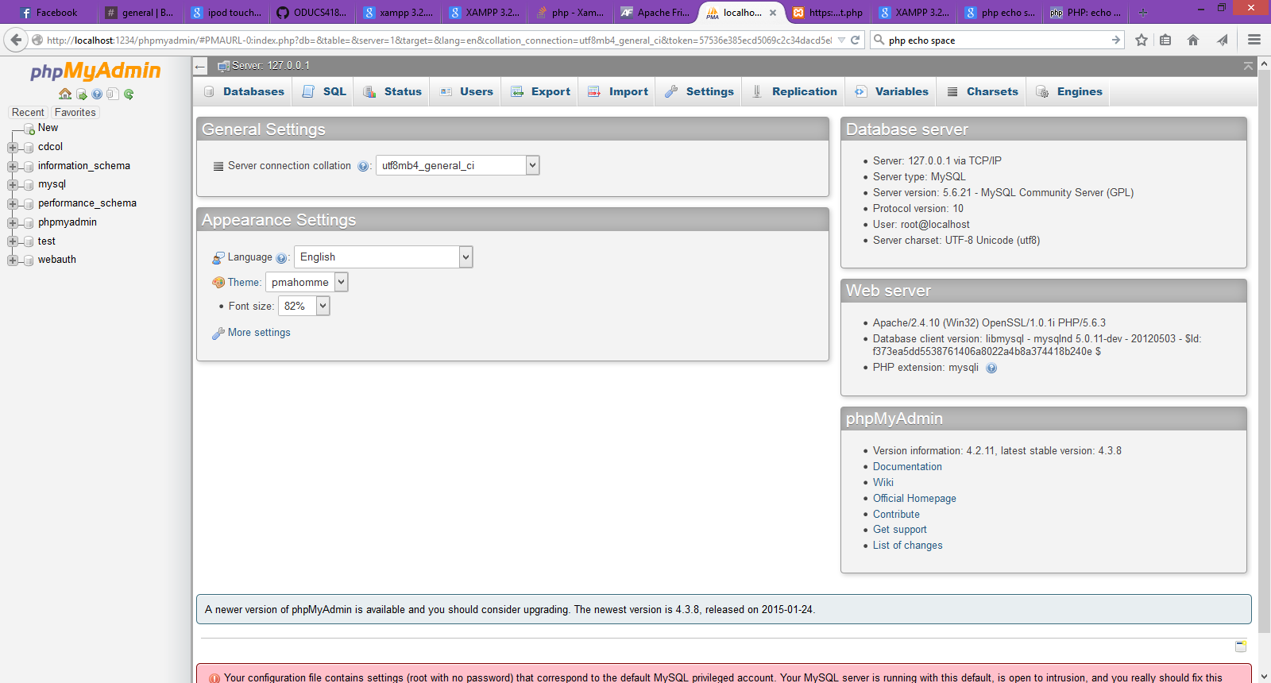
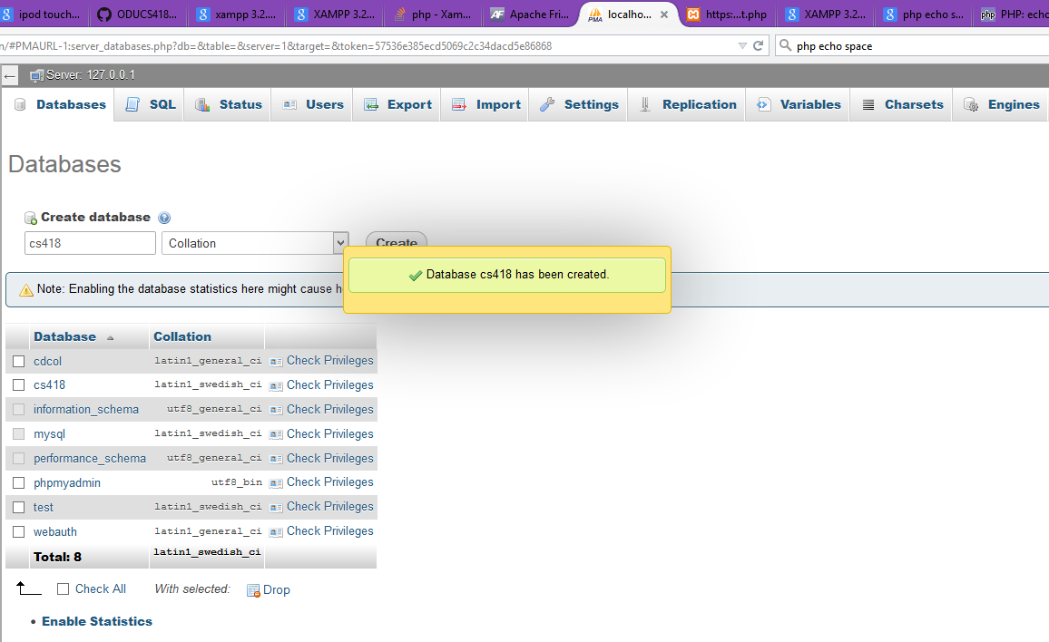
I opened myPHPAdmin and created a database titled ‘cs418’

Slide 8
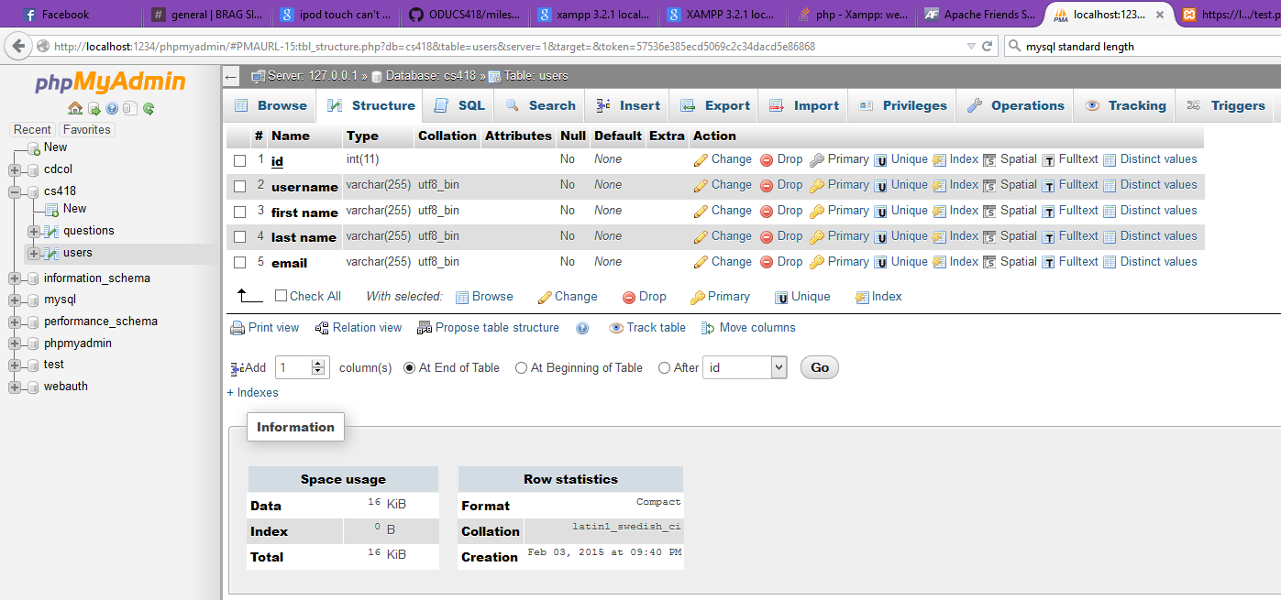
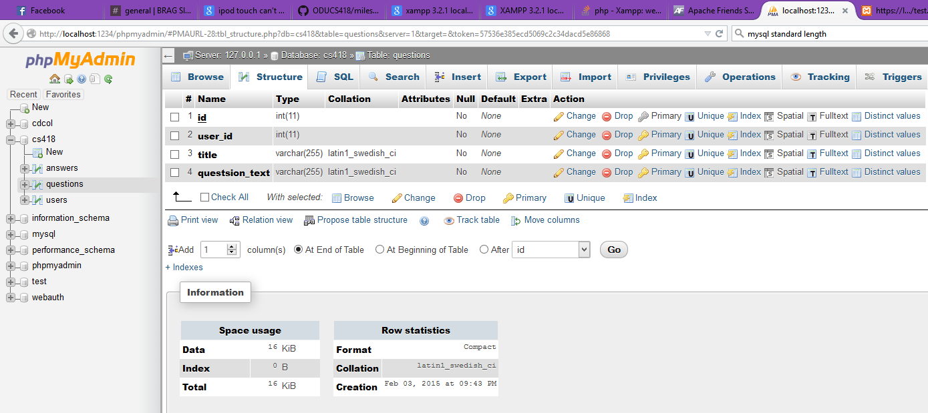
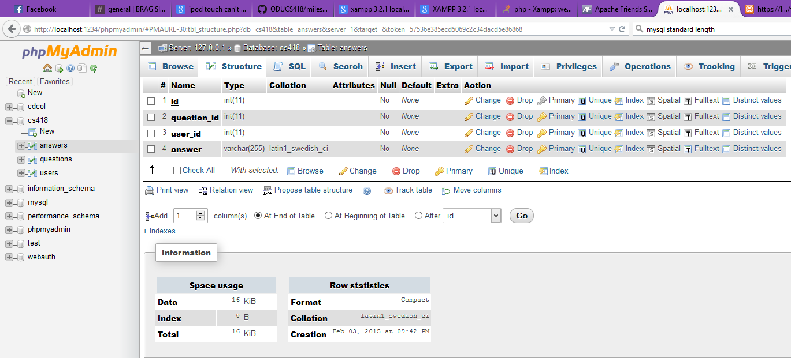
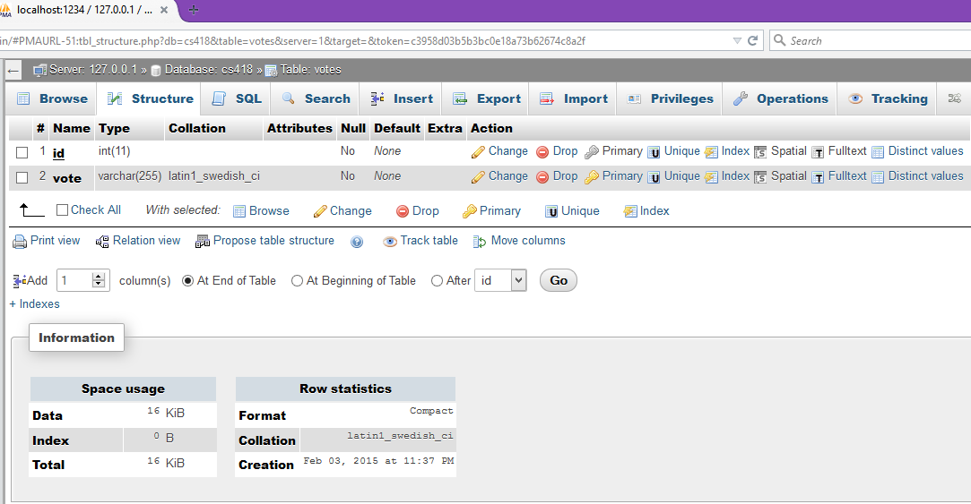
I then created tables titled ‘users’, ‘questions’, ‘answers’, and ‘votes’.

Slide 9
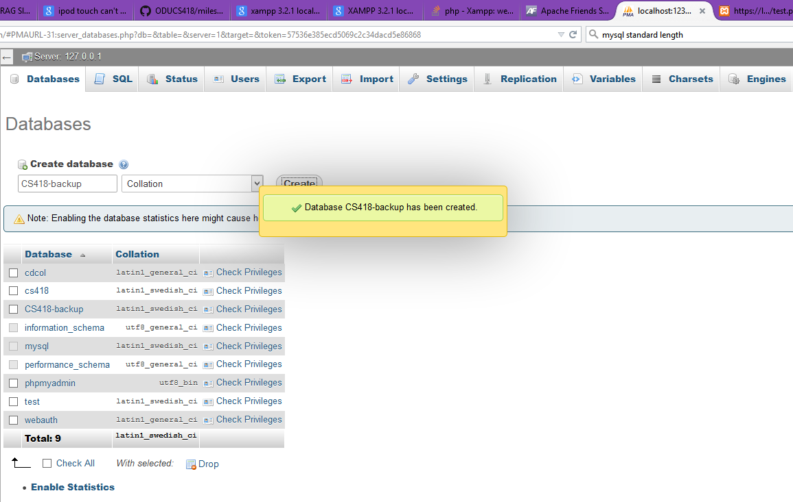
I then created a back-up database

Slide 10
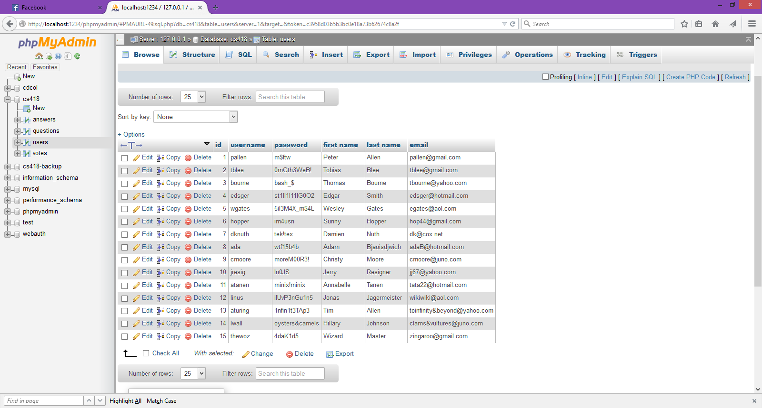
Finally, I populated the user table with the specified credentials

